Slide 1

FAO Data on World Hunger
Presented by: Octave Antoni
Last Updated: June 15th, 2022

Slide 2
Table of contents
Introduction
FAO dataset
Key figures
Conclusion

Slide 3
Introduction

Slide 4
Introduction
Modern world ➔ Still persistent undernutrition
Malnutrition ➔ Leading cause of death even during COVID Pandemic
Global undernutrition trend down, but stagnation since 2014
Sharp rise in 2020, probably due to COVID
Outlook is dire ➔ 10 billion people planned by 2050 and increasing number of conflicts

Slide 5
FAO Dataset

Slide 6
FAO Dataset
Freely available on https://www.fao.org/faostat/en/#data
Many different categories ➔ mainly used : food balance and food security indicators
Possibility to aggregate the items and countries (regions)
Slight inconsistencies between values and theoretical formulas (domestic supply, food)
Food balance data complete, some missing food security indicators
Probably for political reasons, China data duplicated

Slide 7
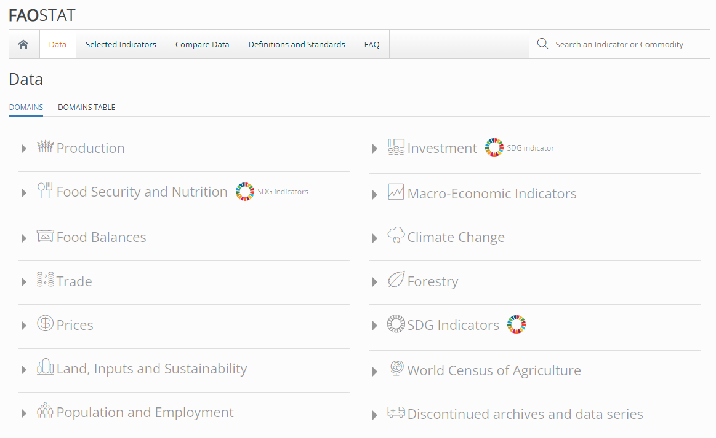
FAO Dataset
https://www.fao.org/faostat/en/#data

Slide 8
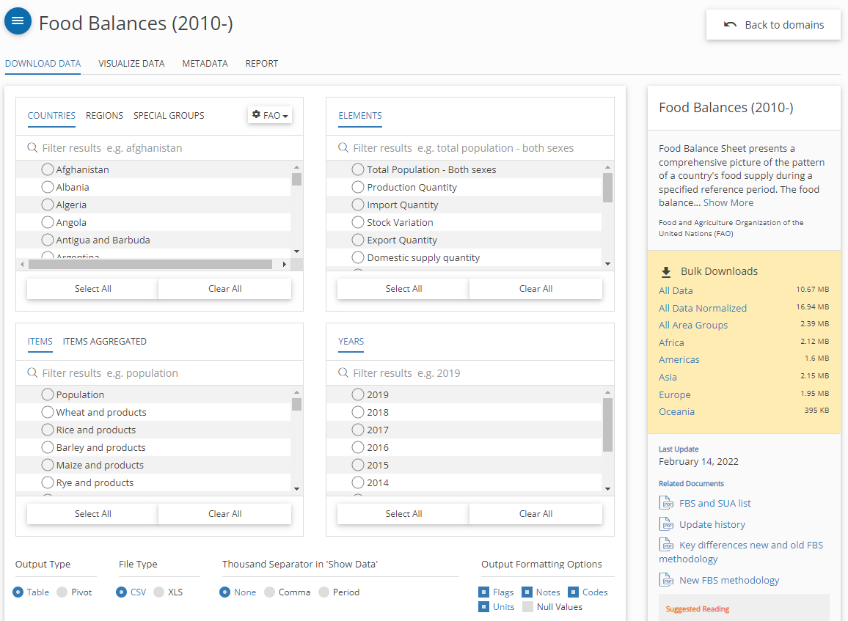
FAO Dataset
https://www.fao.org/faostat/en/#data/FBS

Slide 9
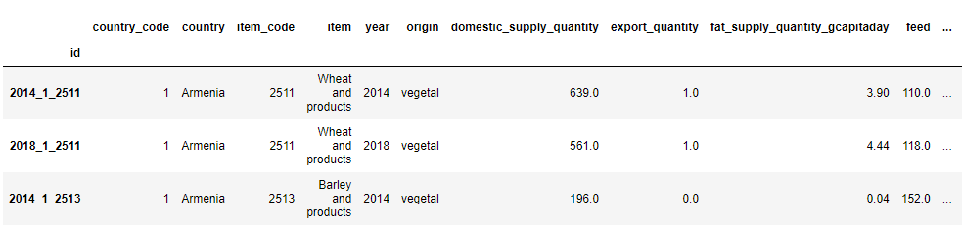
Main dataframe :
One column per year, country and “item” (category of product)
Primary key : composite key made of year, country_code and item_code
18 additional columns with additional information, main columns : food, domestic_supply_quantity, import_quantity, export_quantity, production…

Slide 10
Analysis
Main year of data used for Food Balance : 2018
Historic data for projections
Vegetal based food / animal based food aggregation
Additional data : death rate from malnutrition from Our World in Data (https://ourworldindata.org/grapher/malnutrition-death-rates)

Slide 11
Key figures

Slide 12
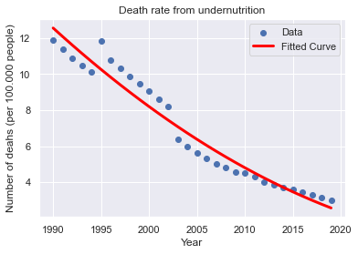
Death rate from undernutrition
The overall trend is down
Numbers remain high :
239.670 people per year
657 people per day
1 person every 2 minutes
Flattening of the curve since 2015
➔ Outlook is rather good, but it remains to be seen whether numbers will increase with Covid

Slide 13
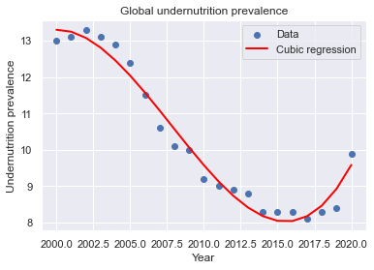
Global undernutrition
Currently about 10% of the population undernourished
Recent Covid related hike
Ukraine crisis will probably accentuate this hike
Short-term outlook : negative
Medium-long term outlook : hopefully will follow global downwards trend

Slide 14
Cause of undernutrition : Analysis of food supply
Current food supply : can feed 124% of population
Only 43% of the vegetal supply and 76% of the animal supply used as food
Total vegetal supply could feed 130% of the world population if it wasn’t used for animal feeding
70% of grain used for animal feeding purposes
US ➔ 51 million additional people (16% of current US population) could be fed if the animal production reduced by 10%

Slide 15
Analysis of countries with undernutrition issues
Analysis of the top 25 items exported by undernourished countries
Used mainly as feed : Maize, Pelagic Fish and Pulse
Problem ➔ These food categories could provide a lot of nutriments if used to feed people
Some items are not only used as food :
Alcohol : pharmaceutical and detergents
Oil crops (non palm) : all kinds of motor oil
Palm Oil : Cosmetic and detergents
505 million people could be fed by oil used for other uses
Export of food in Thailand : exports 56% of its cassava but >8% population undernourished

Slide 16
Conclusion

Slide 17
Conclusion
Undernutrition still a problem in our modernized world
Recent events have led to an increase in chronic undernutrition
Current food production is enough to feed 124% of the world population
Several problems :
Food production isn’t being distributed equally
High amount of supply used as animal feed
Some food items used for other uses (especially oil)
Conflicts and the Covid pandemic are worsening the trend
10 billion people by 2050 : feeding everyone will be a huge challenge
Production will need to drastically increase and food waste needs to be reduced

Slide 18
Questions?

